Slide 1
Smart Crawler Two Stage Crawler Efficiently Harvesting Deep Web Interfaces

Slide 2
Abstract
As deep web grows at a very fast pace, there has been increased interest in techniques that help efficiently locate deep-web interfaces.
However, due to the large volume of web resources and the dynamic nature of deep web, achieving wide coverage and high efficiency is a challenging issue.
We propose a two-stage framework, namely Smart Crawler, for efficient harvesting deep web interfaces.
In the first stage, Smart Crawler performs site-based searching for center pages with the help of search engines, avoiding visiting a large number of pages.
To achieve more accurate results for a focused crawl, Smart Crawler ranks websites to prioritize highly relevant ones for a given topic.
In the second stage, Smart Crawler achieves fast in-site searching by excavating most relevant links with an adaptive link-ranking.
To eliminate bias on visiting some highly relevant links in hidden web directories, we design a link tree data structure to achieve wider coverage for a website.

Slide 3
EXISTING SYSTEM:
Existing hidden web directories usually have low coverage for relevant online databases, which limits their ability in satisfying data access needs.
Focused crawler is developed to visit links to pages of inter stand avoid links to off-topic regions.
A recent study shows that the harvest rate of deep web is low; they just search in Search Index.
Disadvantages:
1. Consuming large amount of data’s.
2. Time wasting while crawl in the web.

Slide 4
PROPOSED SYSTEM:
In this paper, we propose an effective deep web harvesting framework, namely Smart Crawler, for achieving both wide coverage and high efficiency for a focused crawler.
Based on the observation that deep websites usually contain a few searchable forms and most of them are within a depth.
Our crawler is divided into two stages: site locating and in-site exploring. The site locating stage helps achieve wide coverage of sites for a focused crawler, and the in-site exploring stage can efficiently perform searches for web forms within a site. Our main contributions are:
We propose a novel two-stage framework to address the problem of searching for hidden-web resources.
We propose an adaptive learning algorithm that performs online feature selection and uses these features to automatically construct link rankers

Slide 5
MODULE DESCRIPTION:
Number of Modules:
After careful analysis the system has been identified to have the following modules:
1. two-stage crawler.
2. Adaptive learning
3. Admin
4. User

Slide 6
1) Two-stage crawler:
We propose a two-stage framework, namely Smart Crawler , for efficient harvesting deep web interfaces.
In the first stage, Smart Crawler performs site-based searching for center pages with the help of search engines, avoiding visiting a large number of pages.
To achieve more accurate results for a focused crawl, Smart Crawler ranks websites to prioritize highly relevant ones for a given topic.
In the second stage, Smart Crawler achieves fast in-site searching by excavating most relevant links with an adaptive link-ranking.
To eliminate bias on visiting some highly relevant links in hidden web directories, we design a link tree data structure to achieve wider coverage for a website.

Slide 7
2) Adaptive learning:
Adaptive learning algorithm that performs online feature selection and uses these features to automatically construct link rankers.
In the site locating stage, high relevant sites are prioritized and the crawling is focused on atopic using the contents of the root page of sites, achieving more accurate results.
During insite exploring stage, relevant links are prioritized for fast in-site searching.
We have performed an extensive performance evaluation of Smart Crawler over real web data in representative domains

Slide 8
3) Admin
In our proposed architecture admin is a data owner, and perform site ranker and adaptive link ranker.
He search site links from the google search engine according to some topics, and choose links for smart crawling.
He maintains the site database.

Slide 9
4) User
In our proposed architecture user is end user of our application, and data user.
Whenever he wants the data he can search from our application, data retrieve from the google search engine, but when sites are matched with our seed sites then smart crawl results he can get according to ranking.

Slide 10
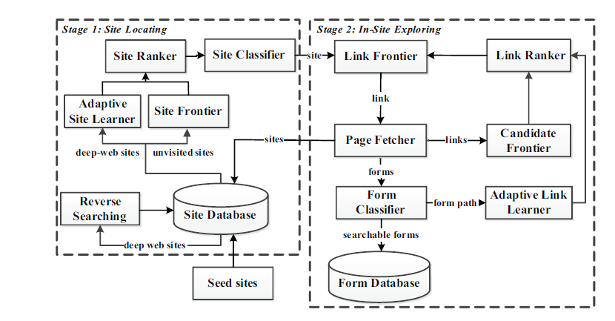
Two-Stage Architecture:-

Slide 11
System Configuration:
HARDWARE REQUIREMENTS:
Hardware - Pentium
Speed - 1.1 GHz
RAM - 1GB
Hard Disk - 20 GB
Key Board - Standard Windows Keyboard
Mouse - Two or Three Button Mouse
Monitor - SVGA

Slide 12
SOFTWARE REQUIREMENTS:
Operating System : Windows Family
Technology : Java and J2EE
Web Technologies : Html, JavaScript, CSS
Web Server : Tomcat
Database : My SQL
Java Version : J2SDK1.5

Slide 13
Use Case Diagram

Slide 14
Class Diagram

Slide 15
Sequence Diagram

Slide 16
Sequence Diagram

Slide 17
Activity Diagram

Slide 18
State Chart Diagram

Slide 19
Component Diagram

Slide 20
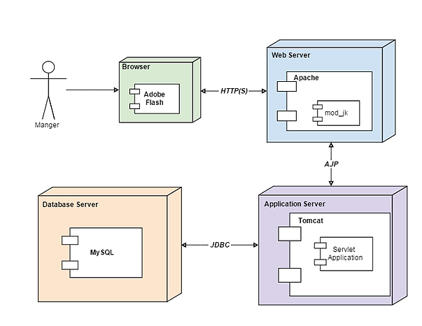
Deployment Diagram

Slide 21
E-R Diagram

Slide 22
Screen Shorts

Slide 23
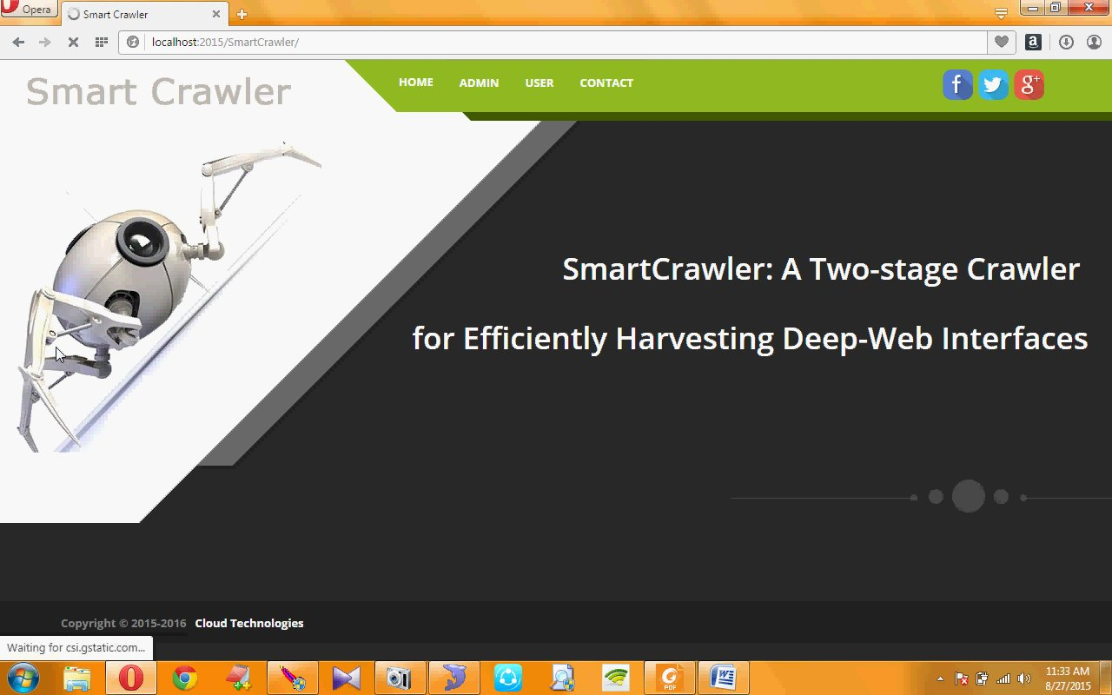

Slide 24
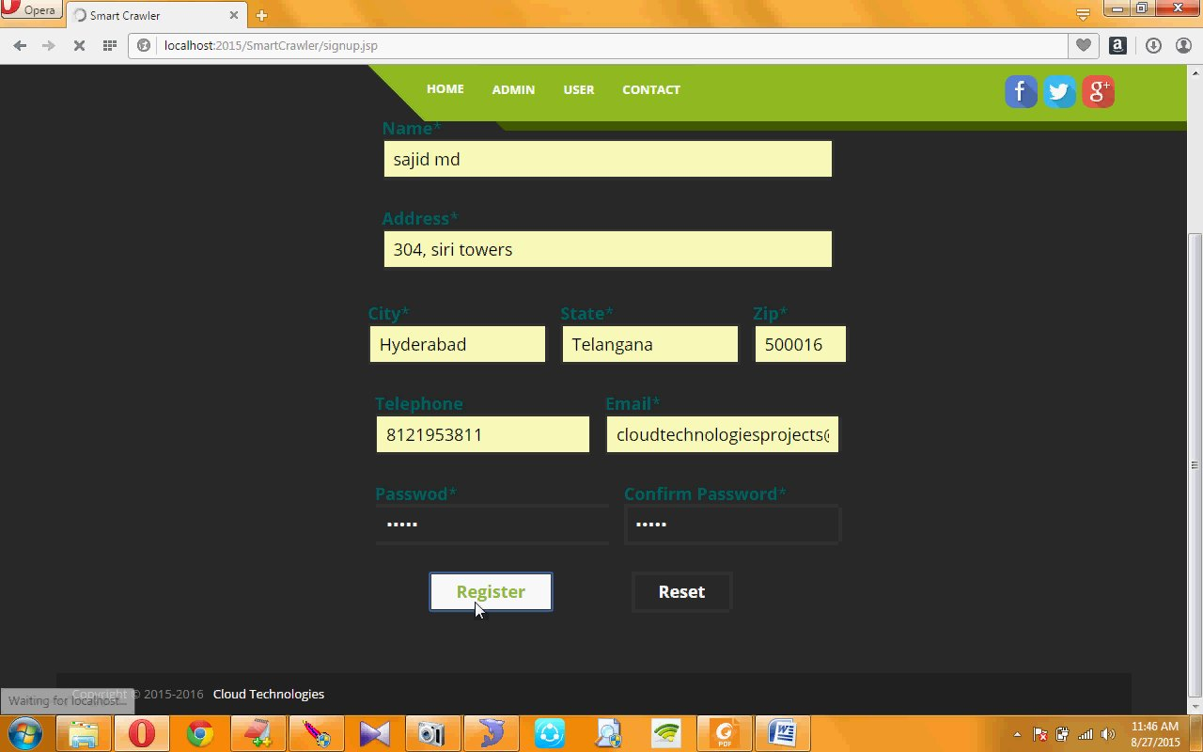

Slide 25
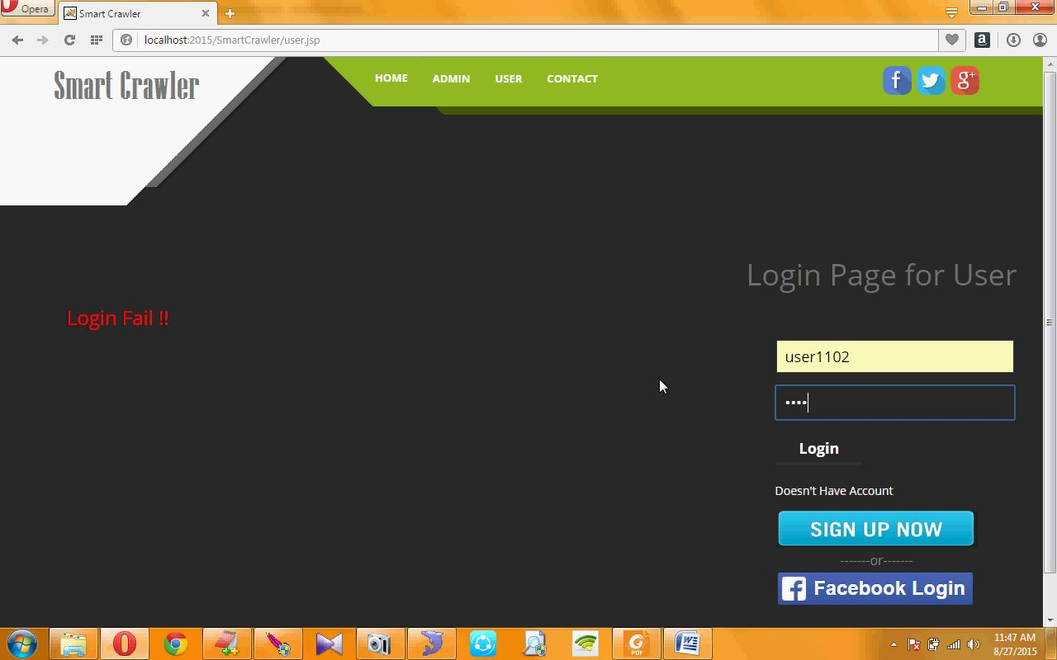

Slide 26
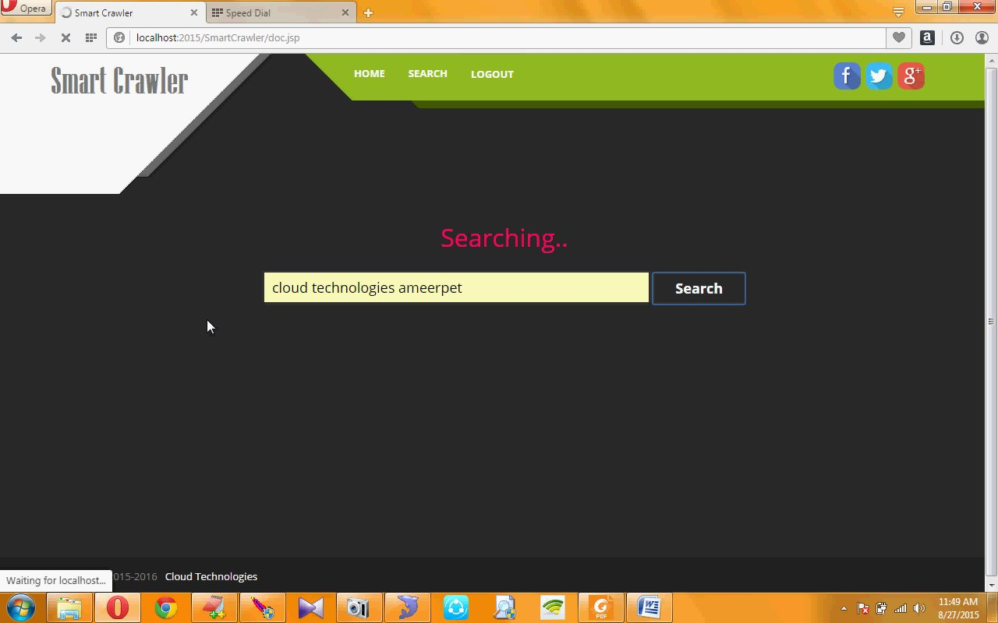

Slide 27
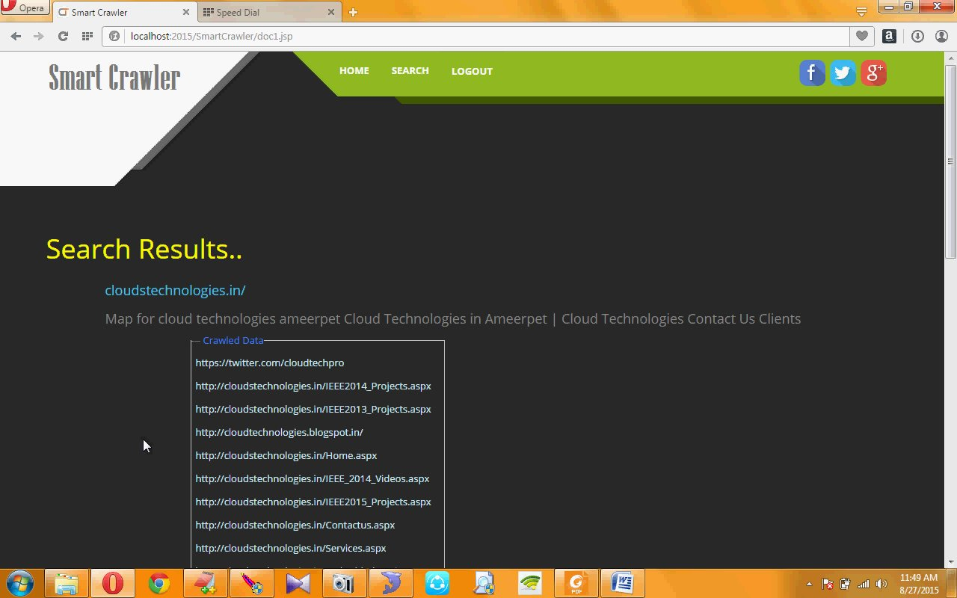

Slide 28
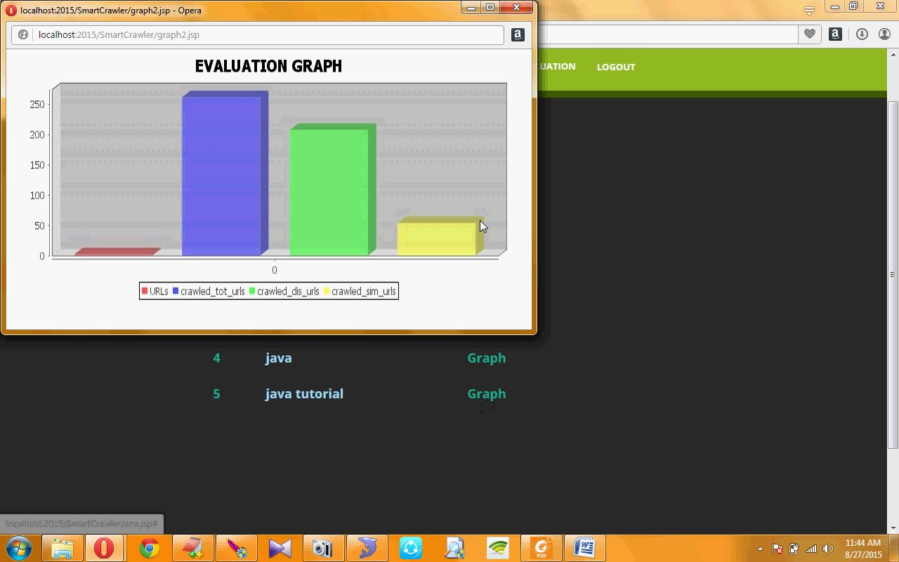

Slide 29
Conclusion:-
Two-stage framework to address the
problem of searching for hidden-web
resources. Smart crawler is easy way to
access the data.

Slide 30


